Slide 1
The New World of
Nutrition Science Communications
Cathy Kapica, PhD, RD
CEO, The Awegrin Institute
EB: April 22, 2013

Slide 2
Science is useless if not effectively communicated

Slide 3
The world has changed
Technology has empowered everyone to be a journalist, increasing individual influence and reach.
  Everyone with an internet connection is an expert.
  Multiple ways to communicate.
    Blog, microblog (tweet), graphics, video, social media
    Information abounds, with no filters

Slide 4
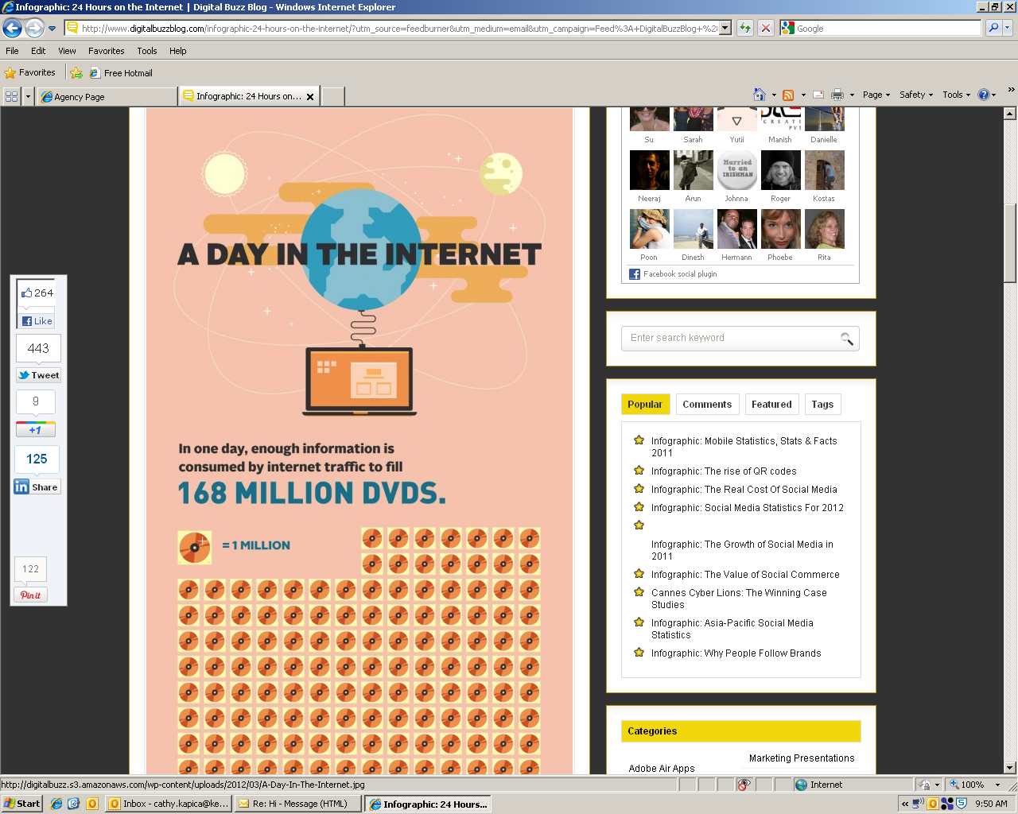
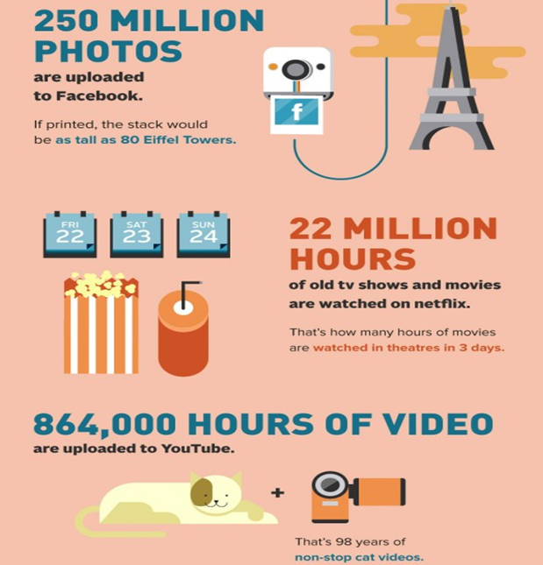
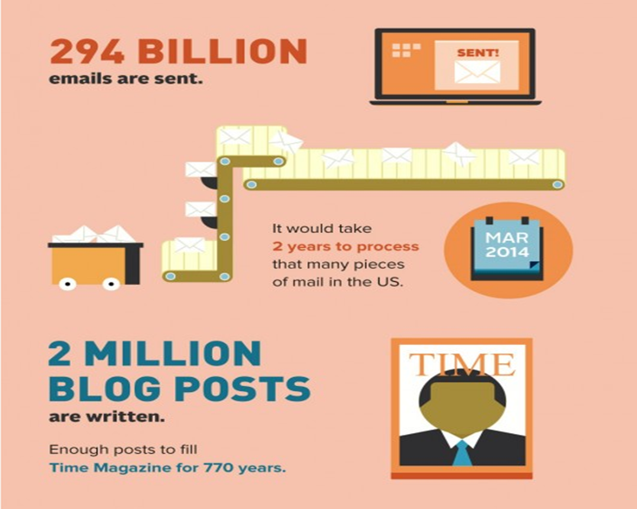
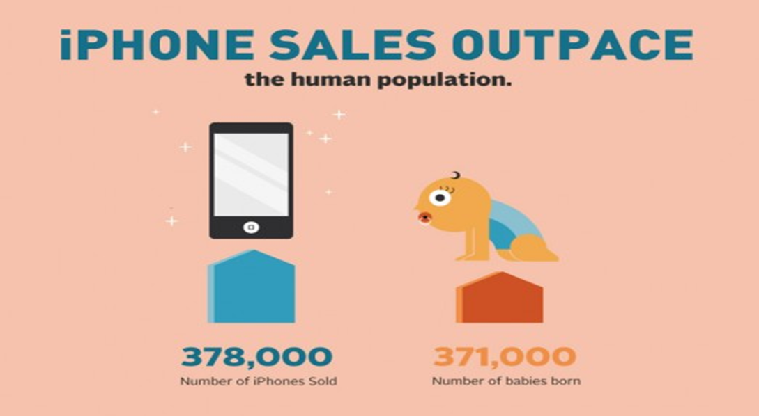

Slide 5
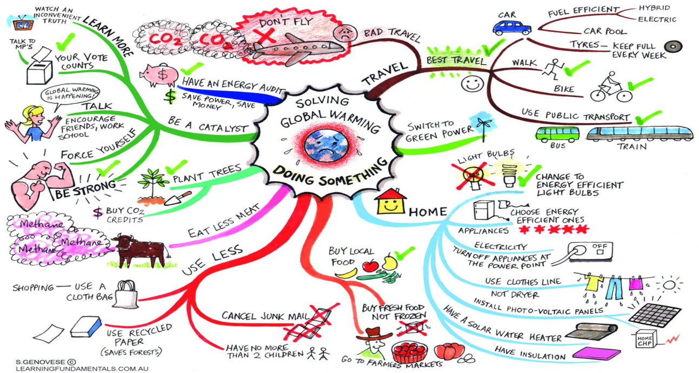
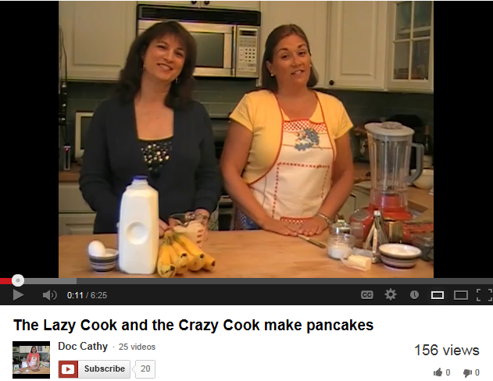
The world has changed
Visual communication is especially critical
  SHORT videos (2-3 minutes)
  Infographics

Slide 6
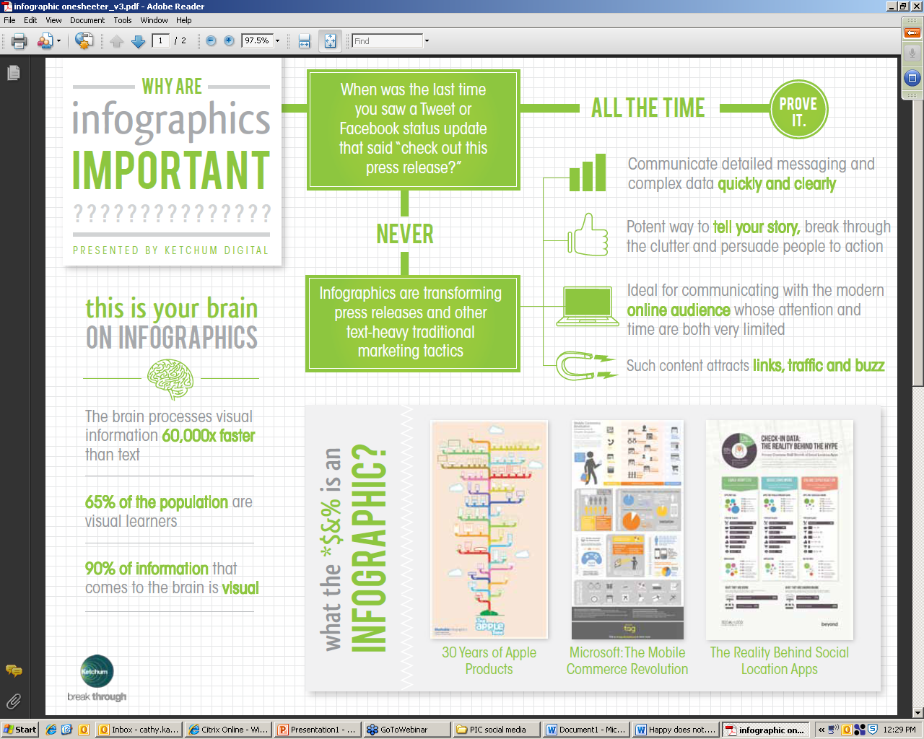

Slide 7
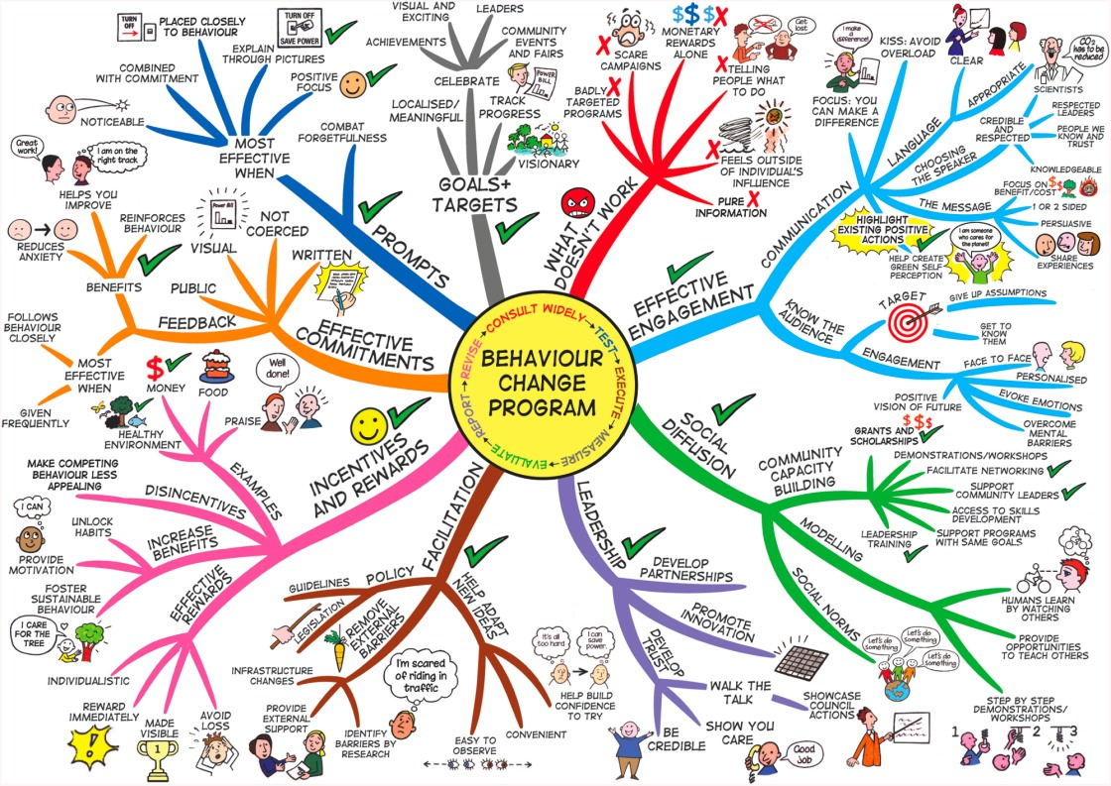

Slide 8

The world has changed
Facts, science, scientists and credentialed experts cannot impact perceptions related to food and nutrition the ‘old-fashioned’ way.
  ’Traditional’ messaging shows you are ‘out of touch’
I have a PhD, so I know best

Slide 9
Influence Shifts to Consumers
Traditional
Today
Scientific evidence creates reasons to believe
Experts and opinion leaders endorse to create reasons to trust
Media coverage of research and expert endorsement drive sustained changes
Scientific evidence creates reason to investigate and debate
Experts and opinion leaders give points of view; engage in the conversation
Friends and family compare, evaluate and recommend online
Tribal legend becomes the ‘truth’
Fact driven
Belief driven

Slide 10

The world has changed
The ‘food involved’ consumer is a new segment of the global population that is THE food and nutrition influencer group of the foreseeable future, defined by proactive online engagement on food, nutrition and agriculture related topics, aligning and coalescing like-minded people around the world.

Slide 11

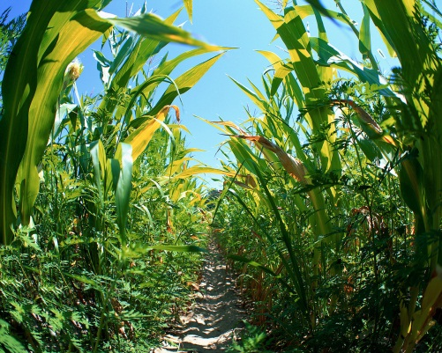

The world has changed
What we say is not what people hear.
  When they do, they are generating a very different meaning than intended.
  How we say it speaks louder than our words.
organic
chemistry
business
organic growth is expanding by increased output, sales, or both (as opposed to “inorganic growth”, growing through mergers, acquisitions, and take-overs).
agriculture

Slide 12
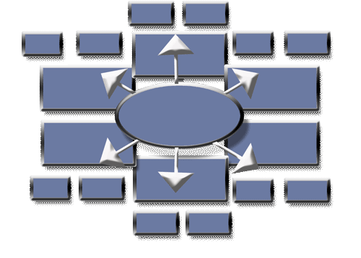
Storytelling…
…communicating more effectively

Slide 13
Effective Communication
Requires Discipline
Focus vs. too much info
Order vs. stream of consciousness
Clarity vs. professional jargon
Complexity is easy.
Simplicity takes a great deal of effort.

Slide 14
Effective Communication =
Good Storytelling
Simple
Memorable
Visual
Structured
Persuasive

Slide 15
How It Works
Fact box
Fact box
Fact box
Fact box
Payoff: Why me?
Landscape:
Challenge and/or
Opportunity
Home Base
Message
Support:
How
Support:
My Response
to Landscape
Support:
How
Fact box
Fact box
Fact box
Fact box
Fact box
Fact box

Slide 16
Storytelling Example
Fact
Fact
Fact
Fact
Communication often
Undisciplined:
unfocused, unclear
Inconsistent and
unsuccessful
Good storytelling =
Successful
communication
We need a more
effective way
communicate
Simple, visual
structure
Supports persuasive
conversations
We need to tell
compelling
stories
Mapping help us do that
Fact
Fact
Fact
Fact
Fact
Fact

Slide 17



FACT: More than half of primary shoppers are “extremely” to “very concerned” about calories.
FACT: XX% of consumers want “natural ingredients.”
FACT: Excess consumption of added sugars has been linked to overweight and obesity around the world.
FACT: 2010 Dietary Guidelines Adv. Comm. calls for significant reduction of added sugars.
FACT: PureCircle provides a proprietary, high-quality stevia leaf for the best tasting stevia sweetness.
People enjoy the sweet taste, yet recognize that too much added sugar many not fit with today’s health needs.
The demand for a natural origin, zero calorie great tasting sweetener has spurred interest in stevia.
FACT: PureCircle stevia is the only one that’s traceable at every phase of production.
Stevia is a natural plant extract that meets consumer and health professional demand for sweetness without the calories.
The Global Stevia Institute brings you the facts you need about the natural origin, zero-calorie sweetener, stevia.
FACT: PureCircle produces more than 90% of world’s stevia with a consistent, stable supply at a commercial level.
FACT: Stevia is from nature.
Leaves from the stevia plant are brewed like tea. The sweetness is extracted from the leaves and purified into a powdered or crystallized form.
GSI’s mission is to tell the stevia story. It is funded by PureCircle, USA.
www.globalsteviainstitute.com
FACT: Stevia is sweet.
It is an intense sweetener, up to 400 times sweeter than sugar.
The story and science about stevia is not well known.
FACT: Stevia is available in foods and beverages around the world.
It is used by major brands like Coca-Cola, Pepsi, Unilever, Danone, and Whitewave Foods.
Stevia can be found in beverages, yogurts, baked goods, salad dressings, tabletop sweeteners and more. It can be used for baking and cooking.
FACT: Stevia is safe.
Regulatory bodies around the world recognize stevia as safe for use by children and adults.
FACT: Stevia is a sustainable crop.
Stevia requires only 1/7th of the land and water needed to grow comparable sweetness from other natural sweet ingredients.

Slide 18
The good news:
We have more opportunities to tell our story
Additional 7-10 Touches
to Reach Acceptance
DECISION
The Teachable Moment
Acceptance
“I believe ..”
Knowledge
7-11 Touches
to Reach Awareness
“I know…”
Understanding
“I understand…
Awareness
“I’ve heard…”

Slide 19

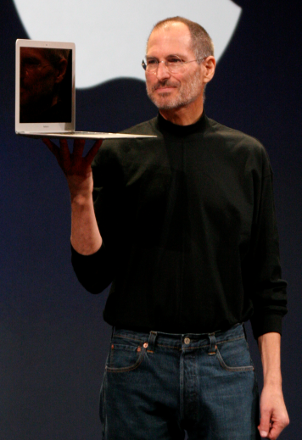
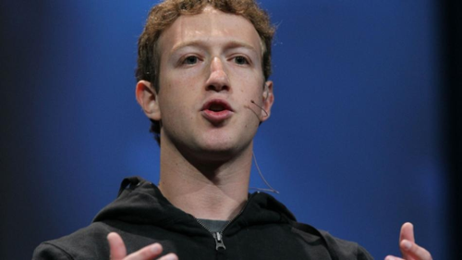
Build your personal brand
What makes you unique?
Memorable?
What do you want to be known for?

Slide 20
Communication model that addresses human needs
start here
why
how
what

Slide 21
How to tell your story in less than 3 minutes
Know your audience.
Start with the end.
Tell it like a story, with a personal dimension and an emotional appeal.
Use tweetable headlines.
Avoid jargon

Slide 22
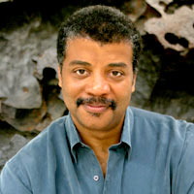
Who is doing it well
If Pizza sizes were given in area not diameter, you'd see instantly that a 7 inch is less than half the size of a 10 inch pie
More evidence my 14 yr old daughter is a Geek: after prompting me to ask if she knew any jokes about sodium, she replied, "Na"
According to the song, Rudolph's nose is shiny, which means it reflects rather than emits light. Useless for navigating fog
Dr. Neil deGrasse Tyson
American astrophysicist and science communicator
Frederick P. Rose Director of the Hayden Planetarium at the Rose Center for Earth and Space in New York

Slide 23
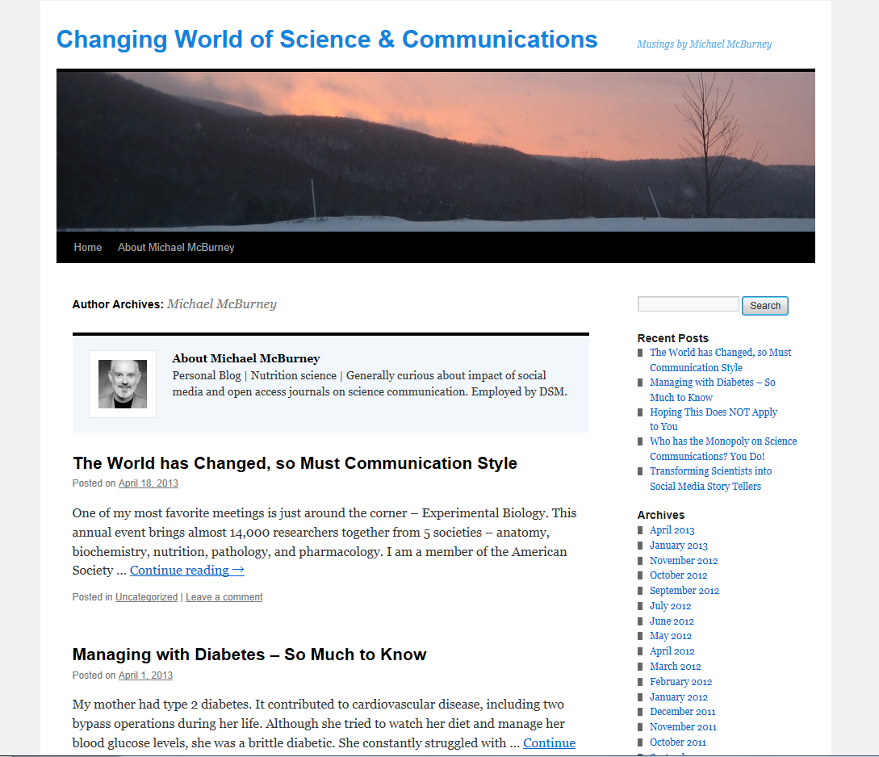
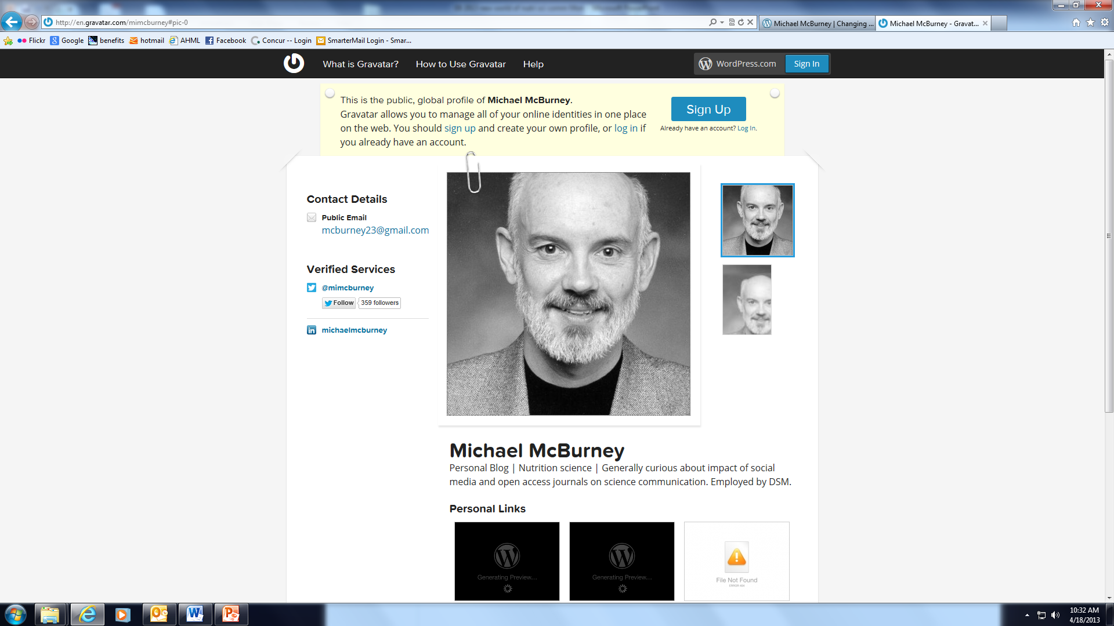
Who is doing it well in nutrition science
Dr. Michael McBurney
Personal Blog | Nutrition science | Generally curious about impact of social media and open access journals on science communication. Employed by DSM.
mimcburney.com/author/mimcburney

Slide 24
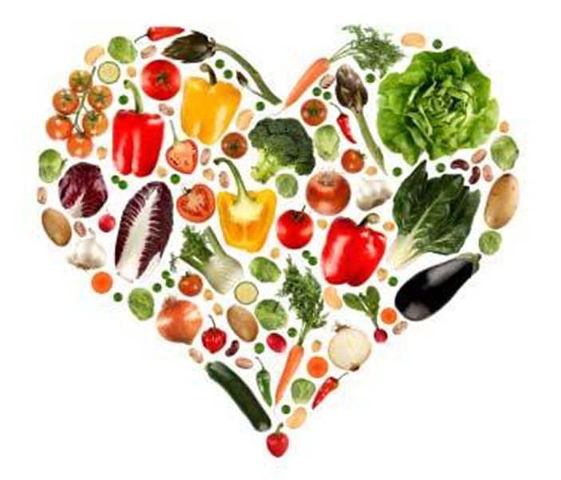
It is your turn to shine!

